Slide 1
PART 2: Statistical Pattern Classification: Optimal Classification with Bayes Rule
METU Informatics Institute Min 720 Pattern Classification with Bio-Medical Applications

Slide 2
Statistical Approach to P.R
Dimension of the feature space:
Set of different states of nature:
Categories:
find
set of possible actions (decisions):
Here, a decision might include a ‘reject option’
A Discriminant Function
in region ; decision rule : if

Slide 3
A Pattern Classifier
So our aim now will be to define these functions
to minimize or optimize a criterion.

Slide 4
Parametric Approach to Classification
'Bayes DecisionTheory' is used for minimum-error/minimum risk pattern classifier design.
Here, it is assumed that if a sample is drawn from a class it is a random variable represented with a multivariate probability density function.
‘Class- conditional density function’

Slide 5
We also know a-priori probability
(c is no. of classes)
Then, we can talk about a decision rule that minimizes the probability of error.
Suppose we have the observation
This observation is going to change a-priori assumption to a-posteriori probability:
which can be found by the Bayes Rule.

Slide 6
can be found by Total Probability Rule:
When ‘s are disjoint,
Decision Rule: Choose the category with highest a-posteriori probability, calculated as above, using Bayes Rule.

Slide 7
then, 1
Decision boundary:
or in general, decision boundaries are where:
between regions and

Slide 8
Single feature – decision boundary – point
2 features – curve
3 features – surface
More than 3 – hypersurface
Sometimes, it is easier to work with logarithms
Since logarithmic function is a monotonically increasing function, log fn will give the same result.

Slide 9
2 Category Case:
Assign to if
if
But this is the same as:
if
By throwing away ‘s, we end up with:
if
Which the same as:
Likelihood ratio

Slide 10
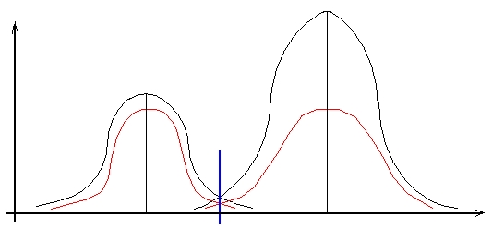
Example: a single feature, 2 category problem with gaussian density
: Diagnosis of diabetes using sugar count X
state of being healthy
state of being sick (diabetes)
The decision rule:
if or

Slide 11
Assume now:
And we measured:
Assign the unknown sample: to the correct category.
Find likelihood ratio: for
Compare with:
So assign: to .

Slide 12
Example: A discrete problem
Consider a 2-feature, 3 category case
where:
And , ,
Find the decision boundaries and regions:
Solution:

Slide 13
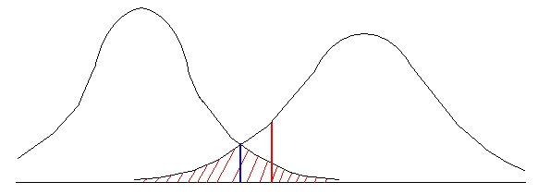
Remember now that for the 2-class case:
if
or
Likelihood ratio
Error probabilities and a simple proof of minimum error
Consider again a 2-class 1-d problem:
Let’s show that: if the decision boundary is (intersection point)
rather than any arbitrary point .

Slide 14
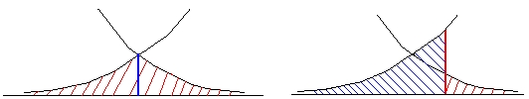
Then (probability of error) is minimum.
It can very easily be seen that the is minimum if .

Slide 15
Minimum Risk Classification
Risk associated with incorrect decision might be more important than the probability of error.
So our decision criterion might be modified to minimize the average risk in making an incorrect decision.
We define a conditional risk (expected loss) for decision when occurs as:
Where is defined as the conditional loss associated with decision when the true class is . It is assumed that is known.
The decision rule: decide on if
for all
The discriminant function here can be defined as: 4

Slide 16
We can show that minimum – error decision is a special case of above rule where:
then,
so the rule is if

Slide 17
For the 2 – category case, minimum – risk classifier becomes:
if
if
Otherwise, .
This is the same as likelihood rule if
and

Slide 18
Discriminant Functions so far
For Minimum Error:
For Minimum Risk:
Where

Slide 19
Bayes (Maximum Likelihood)Decision:
Most general optimal solution
Provides an upper limit(you cannot do better with other rule)
Useful in comparing with other classifiers

Slide 20
Special Cases of Discriminant Functions
Multivariate Gaussian (Normal) Density :
The general density form:
Here in the feature vector of size .
M : d element mean vector
: covariance matrix
(variance of feature )
- symmetric
when and are statistically independent.

Slide 21
- determinant of
General shape: Hyper ellipsoids where
is constant:
Mahalanobis Distance
2 – d problem: ,
If ,
(statistically independent features) then,
major axes are parallel to major ellipsoid axes

Slide 22
if in addition
circular
in general, the equal density curves are hyper ellipsoids. Now
is used for since its ease in manipulation
is a quadratic function of as will be shown.

Slide 23
a scalar
Then,
On the decision boundary,

Slide 24
Decision boundary function is hyperquadratic in general.
Example in 2d.
Then, above boundary becomes

Slide 25
General form of hyper quadratic boundary IN 2-d.
The special cases of Gaussian:
Assume
Where is the unit matrix

Slide 26
(not a function of X so can be removed)
Now assume
euclidian distance between X and Mi
Then,the decision boundary is linear !

Slide 27
Decision
Rule: Assign the unknown sample to the closest mean’s category
unknown sample
d= Perpendicular bisector that will move towards the less probable category

Slide 28
Minimum Distance Classifier
Classify an unknown sample X to the category with closest mean !
Optimum when gaussian densities with equal variance and equal a-priori probability.
Piecewise linear boundary in case of more than 2 categories.

Slide 29
Another special case: It can be shown that when (Covariance matrices are the same)
Samples fall in clusters of equal size and shape
unknown sample
is called Mahalonobis Distance
is called Mahalonobis Distance

Slide 30
Then, if
The decision rule:
if (Mahalanobis Distance of unknown sample to ) >
(Mahalanobis Distance of unknown sample to )
If
The boundary moves toward the less probable one.

Slide 31
Binary Random Variables
Discrete features: Features can take only discrete values. Integrals are replaced by summations.
Binary Features: 0 or 1
Assume binary features are statistically independent.
Where is binary

Slide 32
Binary Random Variables
Example: Bit – matrix for machine – printed characters
a pixel
Here, each pixel may be taken as a feature
For above problem, we have
is the probability that for letter A,B,…
B
A

Slide 33
defined for undefined elsewhere:
If statistical independence of features is assumed.
Consider the 2 category problem; assume:

Slide 34
then, the decision boundary is:
So if
The decision boundary is linear in X.
a weighted sum of the inputs
where:
and

